Slide 1





WordPress Plugins
Popular WP Plugins: Sliders, Forms, Contacts, SEO, Forum, Photo Gallery, e-Commerce
WordPress
Plugins
SoftUni Team
Technical Trainers
Software University
http://softuni.bg

Slide 2



Table of Contents
WordPress Plugins – Concepts
Popular WordPress Plugins
Sliders
Forms
Polls
Photo Galleries
Forums
E-Commerce
SEO
Multilingual
Others

Slide 3
Have a Question?
sli.do #web-basics

Slide 4

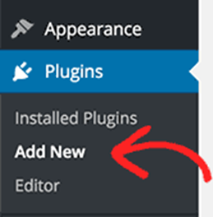


WordPress Plugins
Philosophy and Basic Concepts

Slide 5
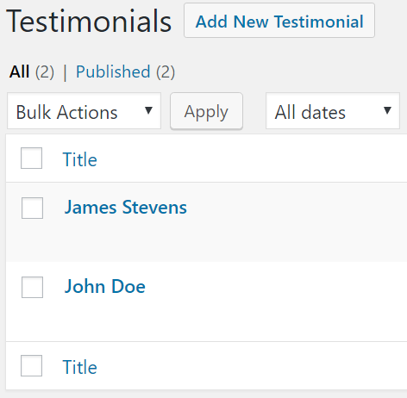
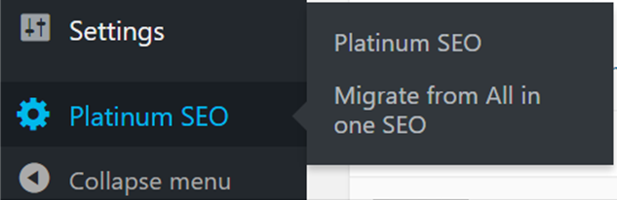
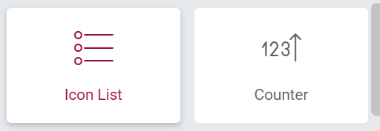
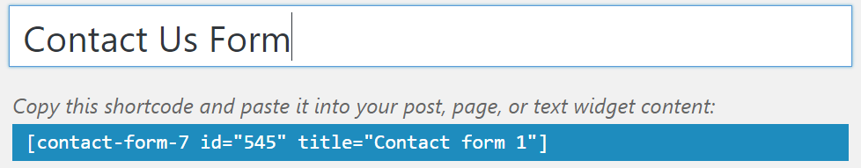
WordPress Plugins
WordPress plugins are additional WP components
Plugins add non-existing functionality / modify WP behavior
New admin menus / admin forms
New widgets / UI / short codes

Slide 6
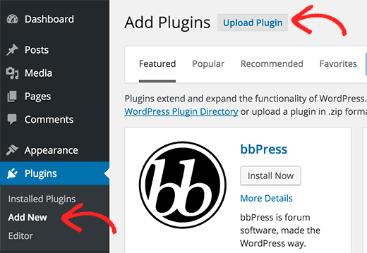
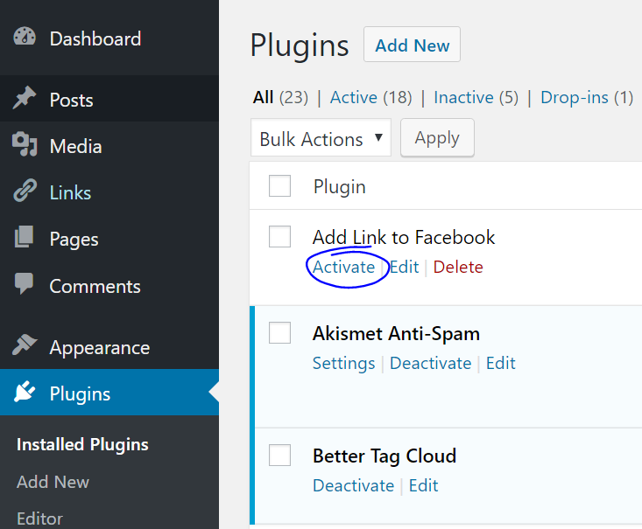
Installing WP Plugins
WordPress official plugin directory: https://wordpress.org/plugins/
Find plugin / install it / activate it

Slide 7



WordPress Sliders

Slide 8
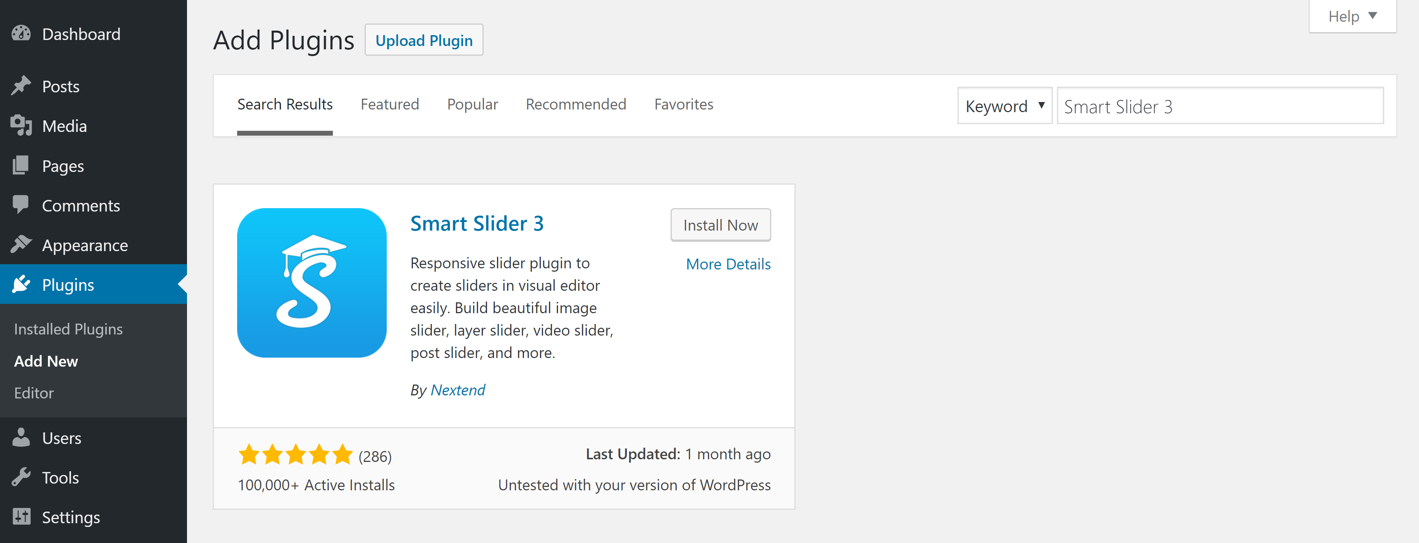
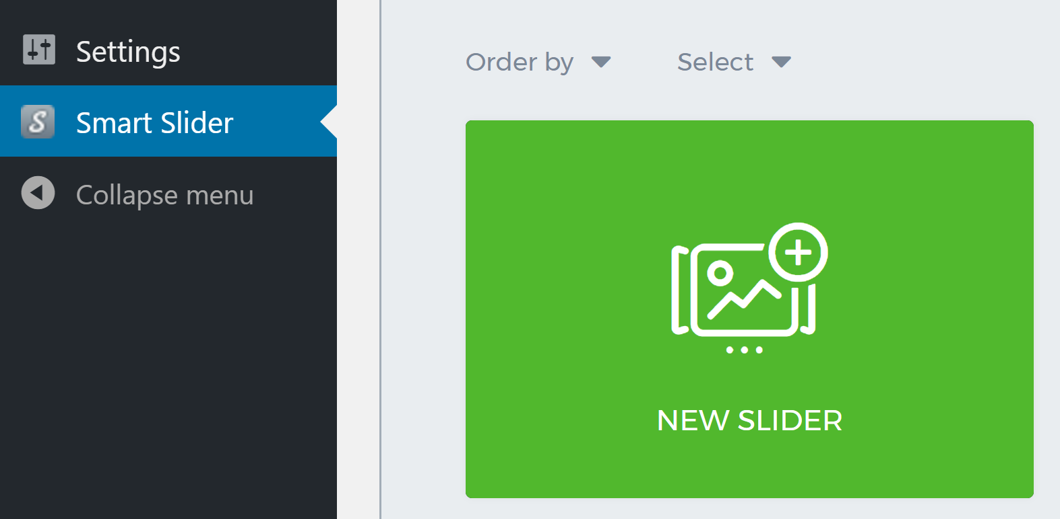
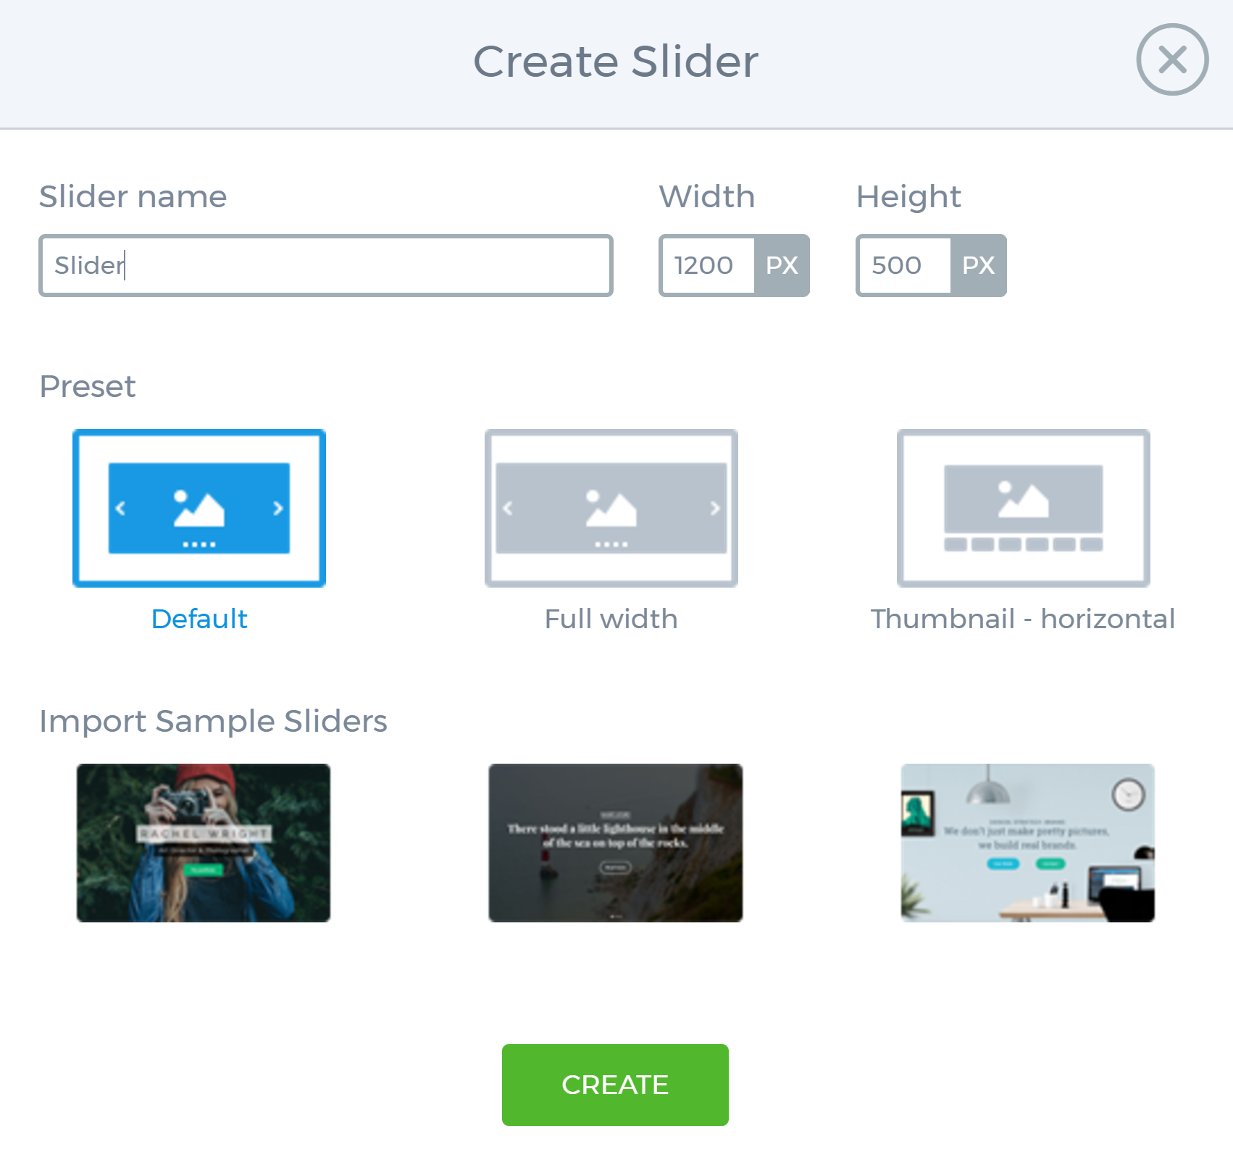
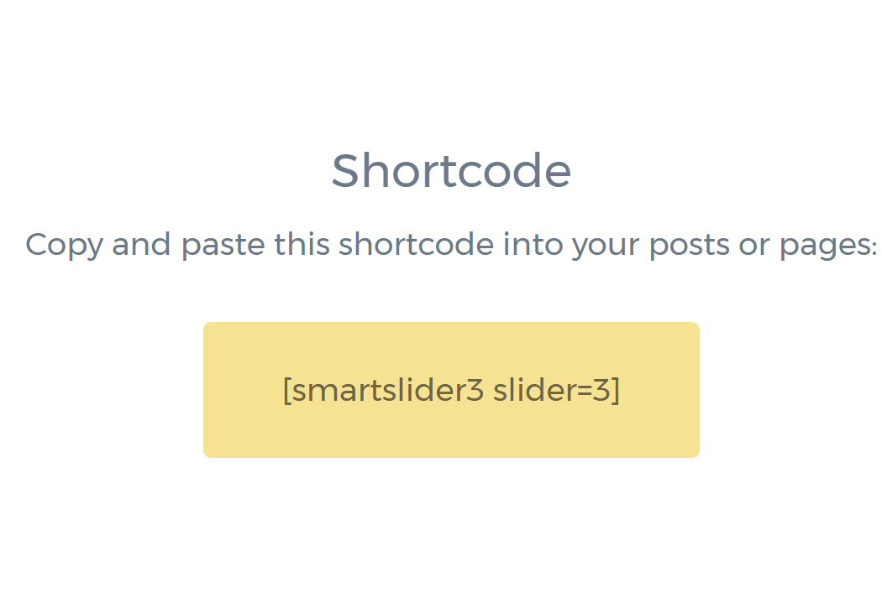
Smart Slider 3 Plugin

Slide 9
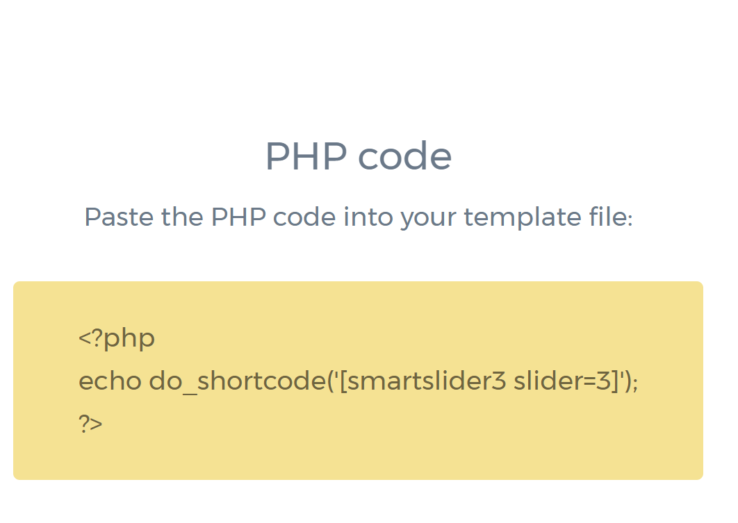
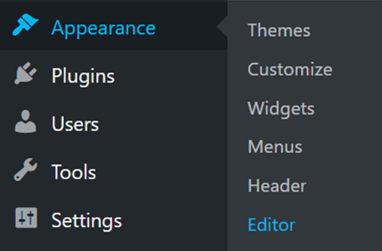
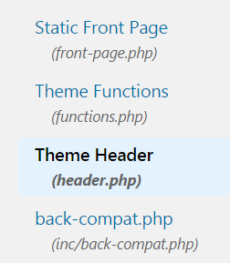
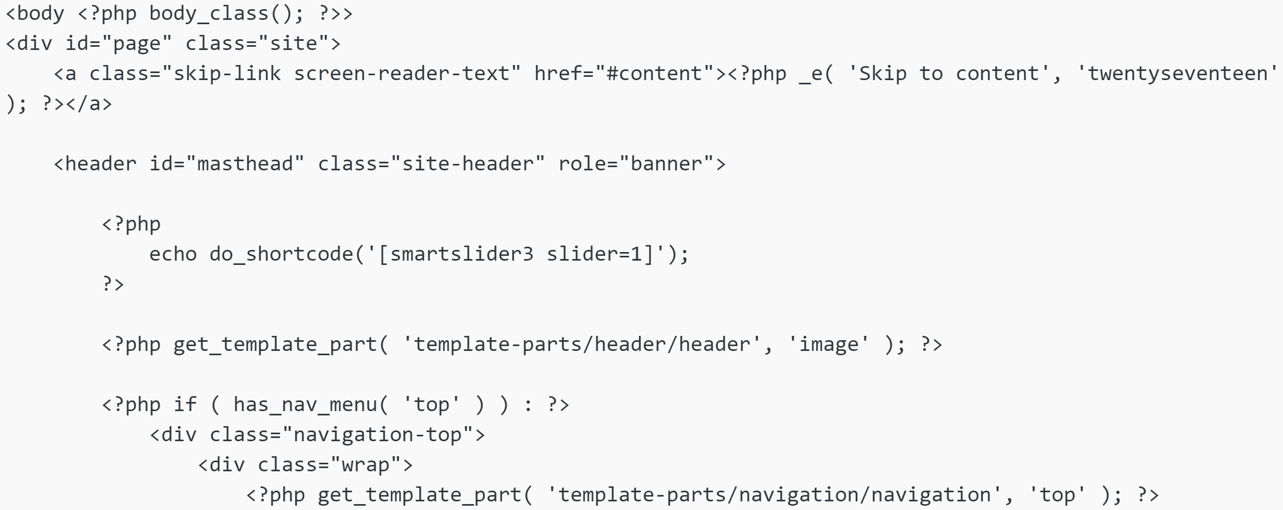

Include Slider in "Twenty Seventeen" Theme

Slide 10

Slider Revolution
"Slider Revolution" is powerful slider plugin
Paid product, comes with some WP themes
https://revolution.themepunch.com
Examples:
https://revolution.themepunch.com/wordpress-header-image/
https://revolution.themepunch.com/wordpress-double-exposure-effect/
https://revolution.themepunch.com/snow-effect-add-on/
https://revolution.themepunch.com/wordpress-newsletter-signup/
https://revolution.themepunch.com/best-wordpress-slider-plugin-2016/

Slide 11

WordPress Forms Plugins
Contact Form 7

Slide 12
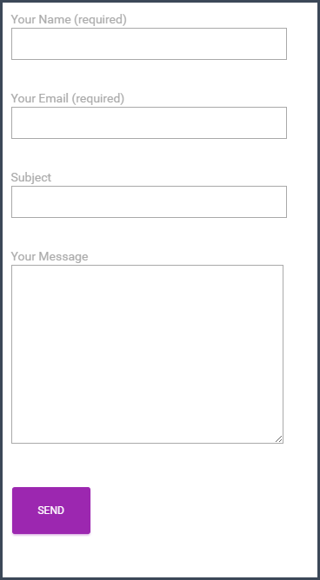
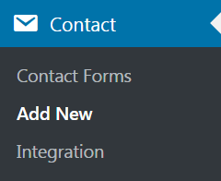
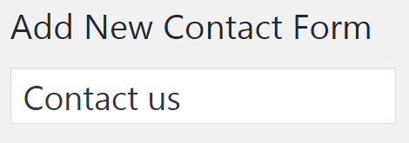
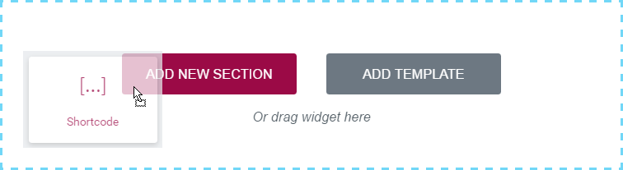
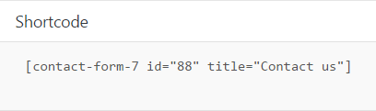
Contact Form 7
Create a form in "Contact Form 7"

Slide 13
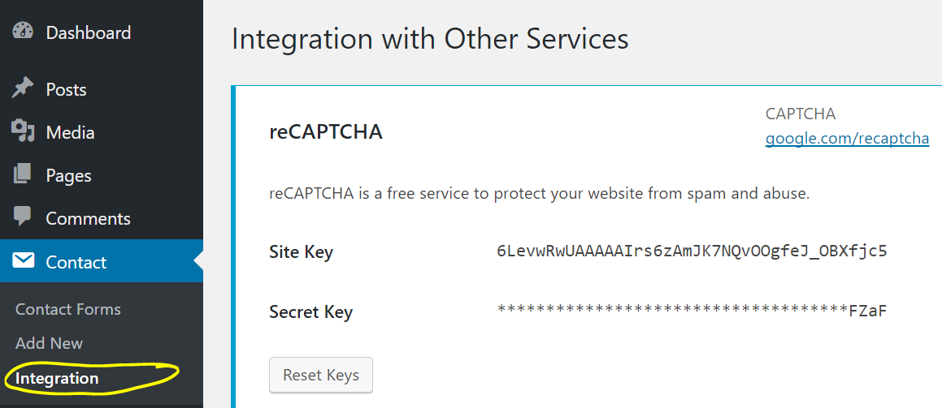
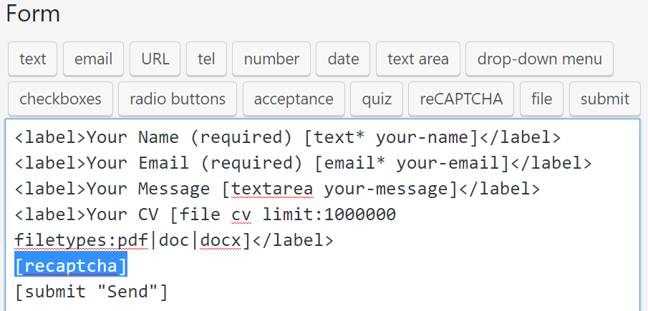
Using an Anti-Spam Capture (reCAPTCHA)

Slide 14
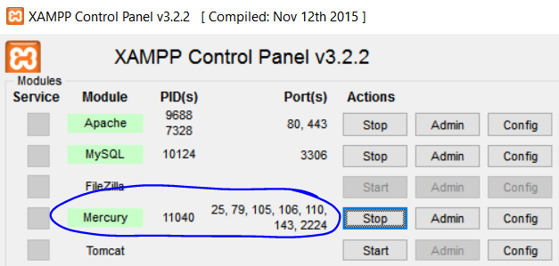
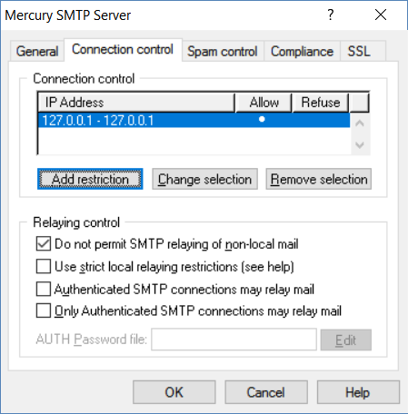
Contact Form 7 & Mail Setup
Sending emails from WordPress requires a mail server (SMTP)
Hosting companies provide SMTP server with your account
In XAMPP you need to setup a local SMTP (e.g. Mercury)
Beware: emails may get lost!
E.g. get marked as "SPAM" or just don't arrive

Slide 15
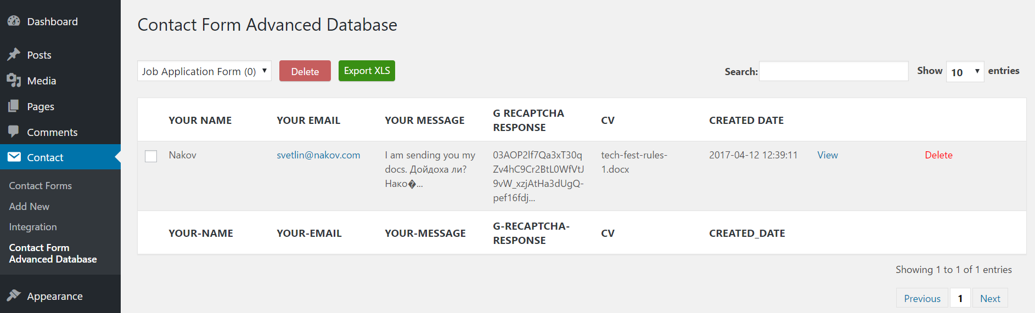
Database for Contact Form 7
Collect Contact Form 7 submissions in the WordPress database
Install "Contact Form Advanced Database" plugin

Slide 16
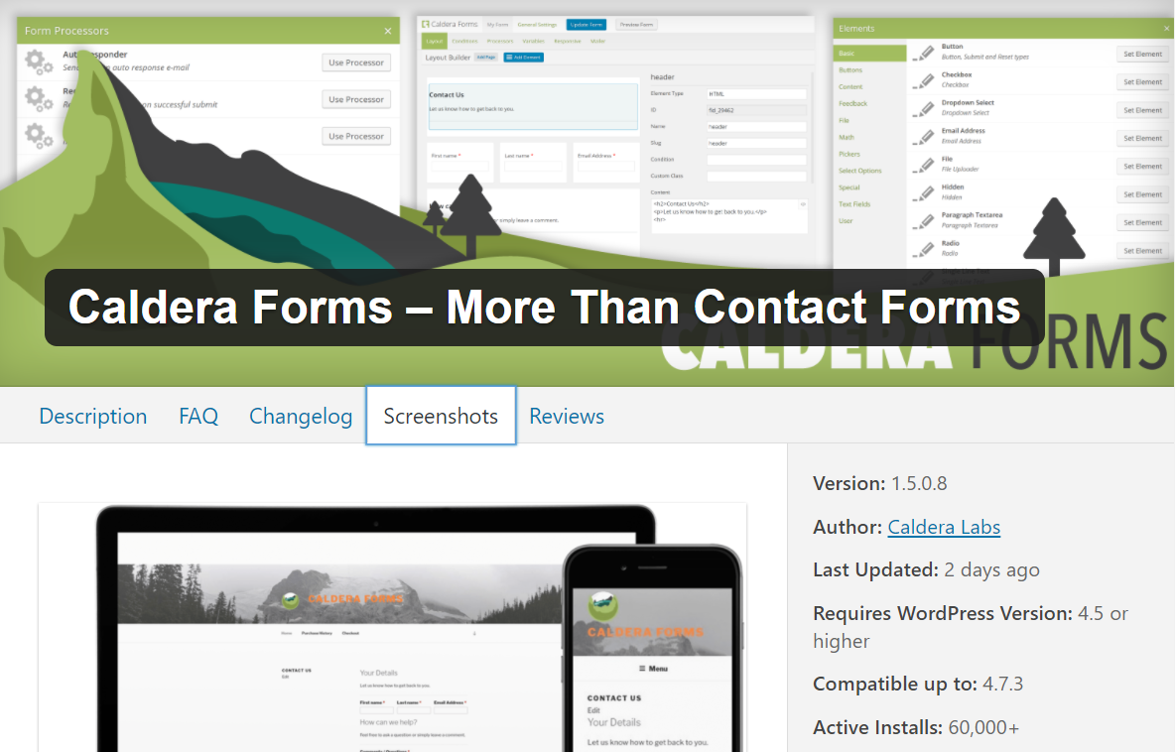
Caldera Forms – Form Builder for WP
Caldera Forms – https://calderaforms.com
Visual interactive form builder WP plug-in
Very powerful
Many controls
Collected form data
Sent by email
Stored in the DB

Slide 17
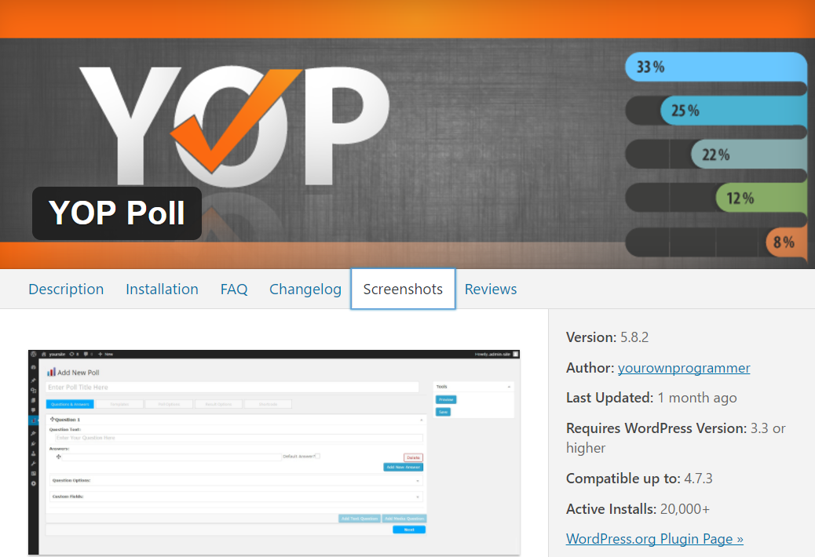
WordPress Polls (Vote for a Question)

Slide 18
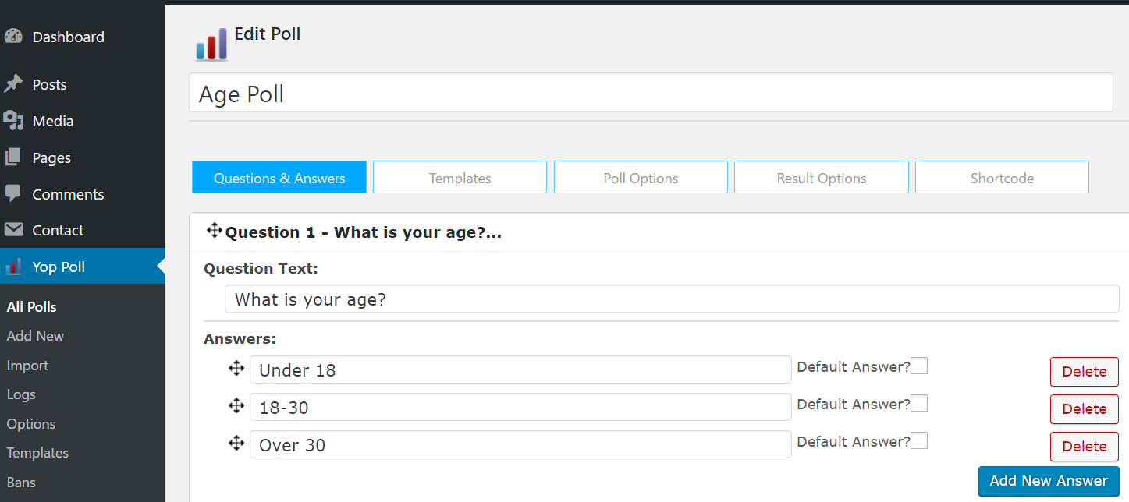
YOP Poll
"YOP Poll" plugin: create polls inside your WP site

Slide 19
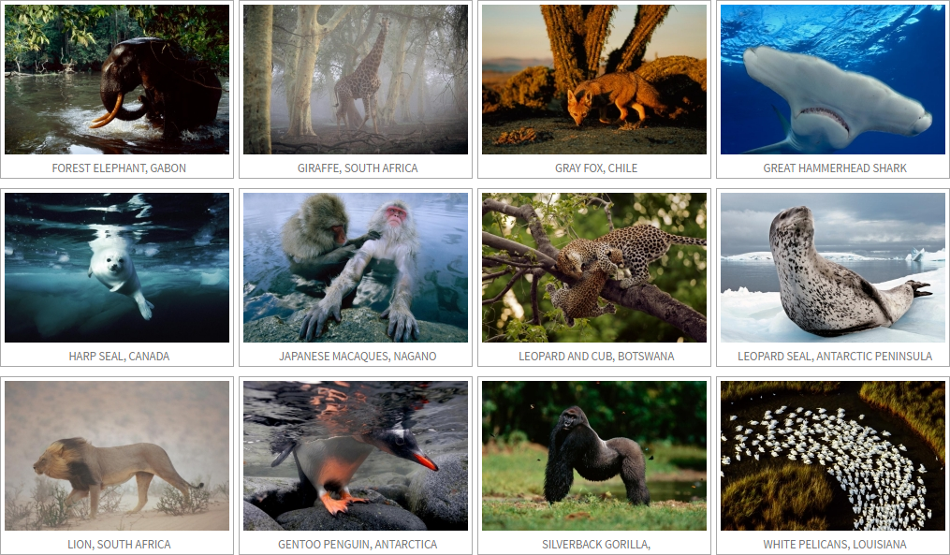
NextGEN Gallery
Embed Photo Galleries in WordPress Sites

Slide 20
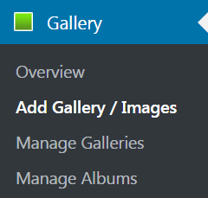
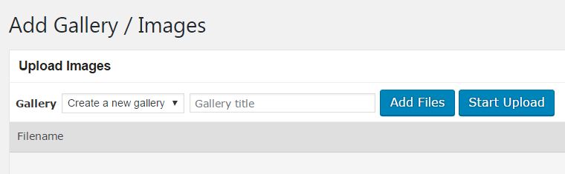
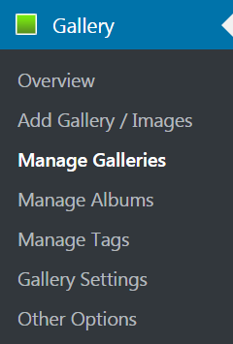
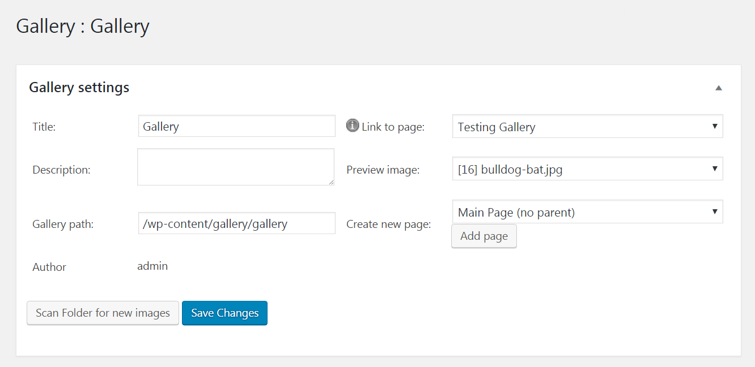
NextGEN Gallery

Slide 21
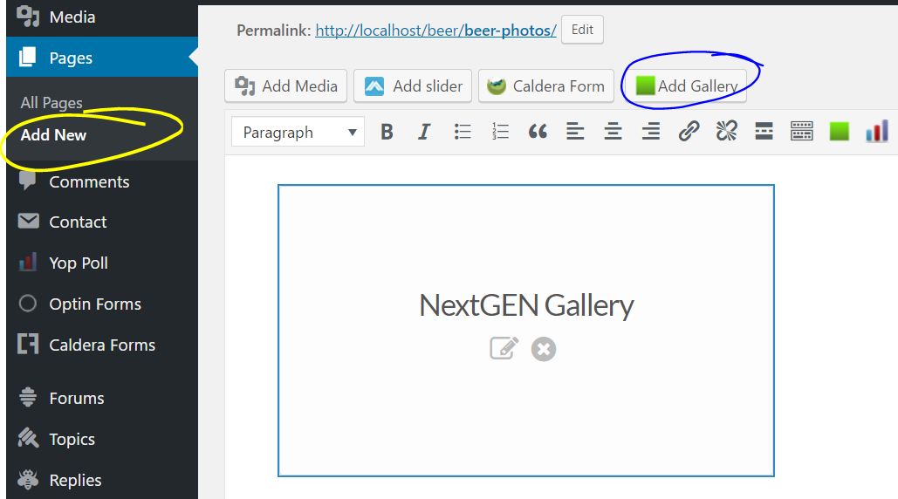
Pages holding Galleries

Slide 22

bbPress Plugin
Creating Forums in WordPress Sites

Slide 23
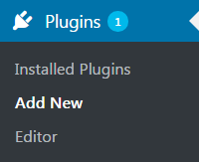


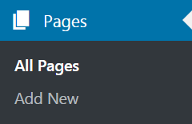
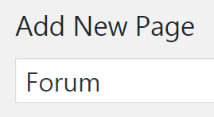
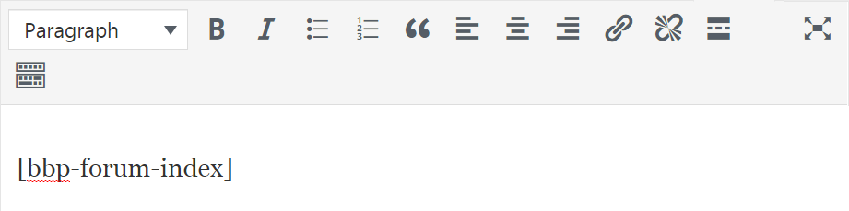
Install bbPress
Install the "bbPress" plugin
Create "Forum" page and put the forum short code
https://codex.bbpress.org/features/shortcodes/

Slide 24
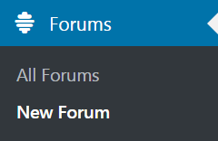
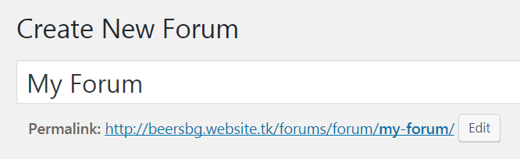
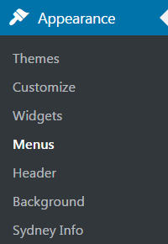
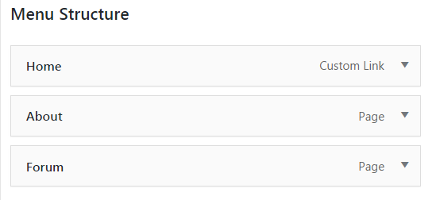
Create bbPress Forum
Create a new forum in bbPress

Slide 25
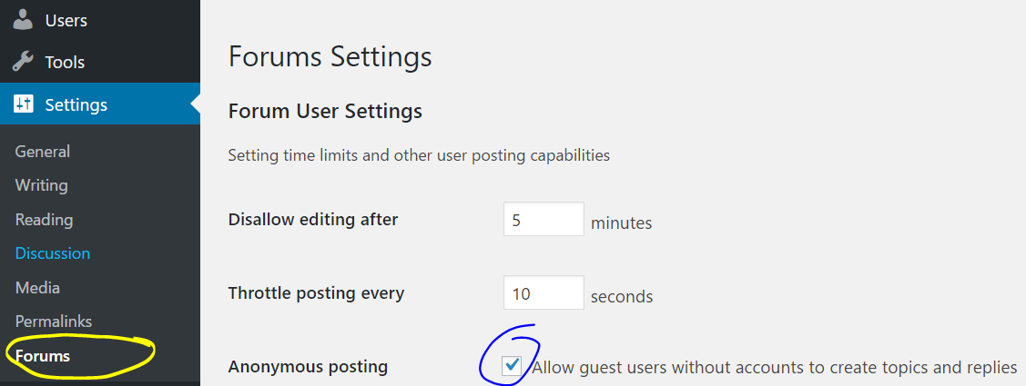
Customize the bbPress Forum
No easy way to change the UI theme (need to edit the CSS)

Slide 26

eCommerce Plugins for WP
wooCommerce

Slide 27
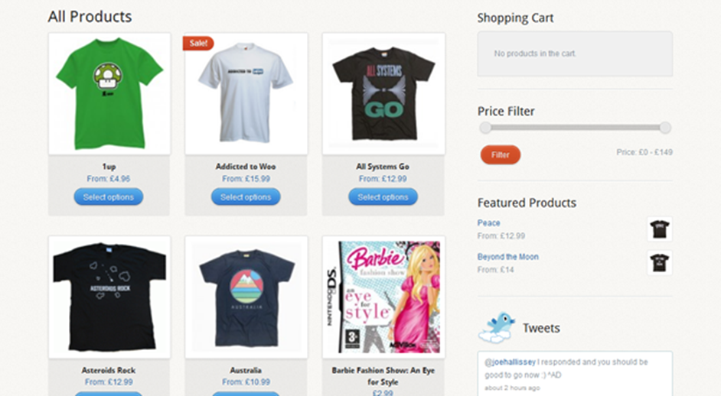
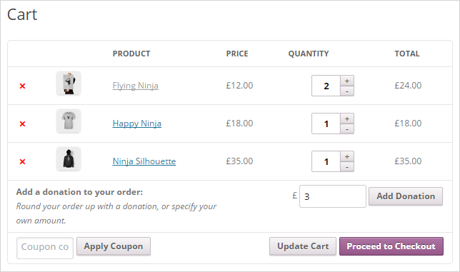
wooCommerce – the #1 e-commerce for WP
Watch the wooCommerce video guide as a start
https://docs.woocommerce.com/document/woocommerce-guided-tour-videos/

Slide 28
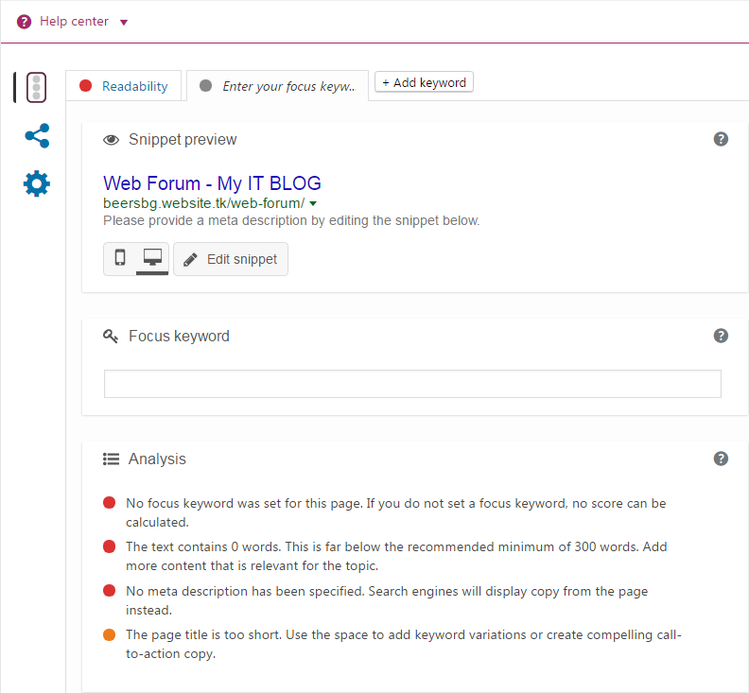

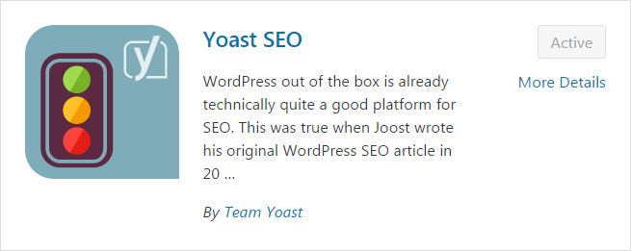
WordPress SEO
WordPress SEO Plugin

Slide 29
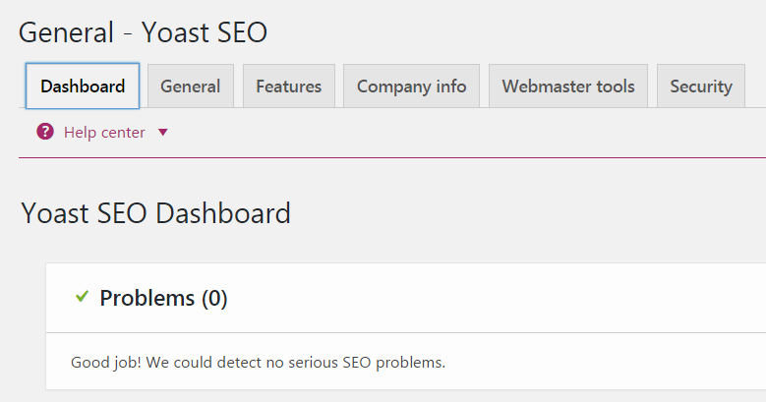
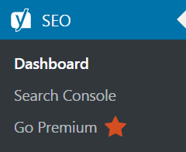
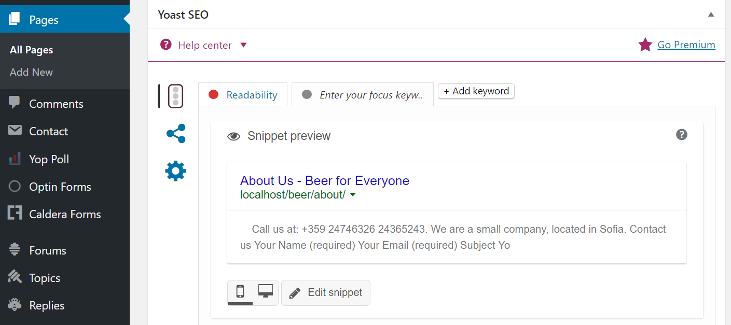
SEO Plugins: Yoast SEO

Slide 30


Multi-Language WP Plugins
The "Polylang" Plugin

Slide 31


Polylang – Translate WP Sites
Install and activate the "Polylang" plugin
Add at least 2 languages (e.g. EN + BG)

Slide 32



Translate Posts / Pages / Strings / Others
Translate posts / pages
Side-by-side pages / posts
Language sidebar widget
String translations

Slide 33
Other WordPress Plugins

Slide 34

Show Events of Business
TM Timeline
Modify Layout
Change visible items limit
Choose date format
Display anchors
Create event group
https://wordpress.org/plugins/tm-timeline

Slide 35

Design a WP Blog
Blog Designer
Fully Responsive
Cross Browsers Support
6 Default Blog Templates
Style your content
Custom CSS support
https://wordpress.org/plugins/blog-designer

Slide 36


Move a WP Web Site
All-in-One WP Migration – backup / restore WordPress sites
Export / import your database, media files, plugins, and themes
https://wordpress.org/plugins/all-in-one-wp-migration/

Slide 37
Other Plugins
Caching plugins – speed-up page loading
HyperCache Extended – https://wordpress.org/plugins/hyper-cache-extended/
WP Super Cache – https://wordpress.org/plugins/wp-super-cache/
Widget Context – show / hide widgets on some pages
https://wordpress.org/plugins/widget-context/
Better Tag Cloud – good-looking cloud of tags
https://wordpress.org/plugins/nktagcloud/

Slide 38

Summary
WordPress plugins extend WP build-in functionality
Add admin sections / widgets / short codes / other functionality
Popular WP plugins:
Forms, sliders, galleries, forums, SEO, e-commerce, caching, widgets, etc.
Smart Slider 3, NextGEN Gallery, BBPress, Yoast SEO, wooCommerce, …
Thousands of WP plugins (free and paid)
Just find the correct one for your case

Slide 39







WordPress Plugins
https://softuni.bg/courses/wordpress-basics

Slide 40

License
This course (slides, examples, demos, videos, homework, etc.) is licensed under the "Creative Commons Attribution-NonCommercial-ShareAlike 4.0 International" license

Slide 41





Free Trainings @ Software University
Software University – High-Quality Education, Profession and Job for Software Developers
softuni.bg
Software University Foundation
softuni.org
Software University @ Facebook
facebook.com/SoftwareUniversity
Software University Forums
softuni.bg/forum

